Slide 1
TEXT ENCAPSULATION: SUMMARIZATION TO THE MINIMUM
By
Imran Ali
st 107626
Committee:
Dr. Sumanta Guha (Chairperson)
Prof. Phan Minh Dung (Member)
Dr. Paul Janecek (Member)

Slide 2
Overview
Background
Problem Statement
Objectives
Assumptions and Limitations
Literature Review
Methodology

Slide 3
Background
Automatic Summarization: a concise version of a text generated by a computer program.
  The concise version retains most important information.
Research work in text summarization dates back to 1955.

Slide 4
Genres of Summary
Abstract: rephrasing original contents, requires semantic analysis
Extracts: represent important information using the text itself, statistical techniques are used

Slide 5
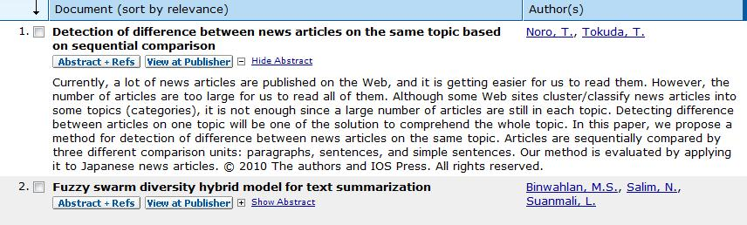
Abstract
Mostly written by experts
  e. g. abstracts of a research article
Notes:
The image is taken from www.scopus.com. The search results for articles are displayed. Each article’s title is accompanied by Abstracts written by the author.

Slide 6
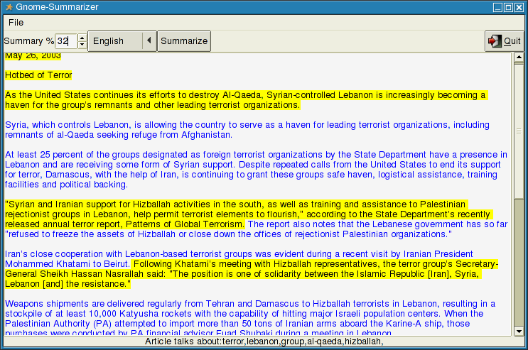
Extracts
Small Segments of a text, that convey most important information
Notes:
In the image is the Open Text Summarizer(OTS). It highlights sentences containing most important information

Slide 7
Genres of Summary
Single Document: Source is a single document. Frequency based methods are comparatively less effective .
Multiple Document: Source is a voluminous collection of text. Information Retrieval techniques are suitable.

Slide 8
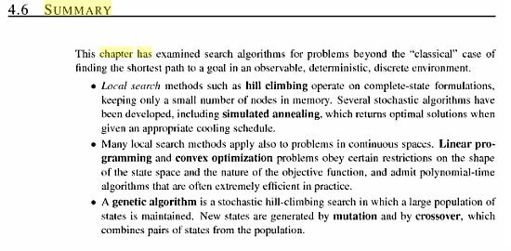
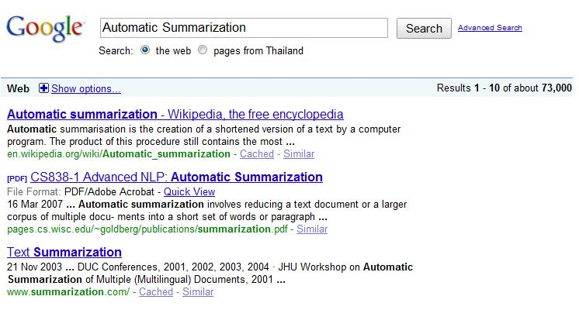
Genres of Summary
Indicative Summary: is user focused and based on query, used for quick categorization, generated on the fly.
Informative Summary: independent of user query, do not change in content.

Slide 9
Genres of Summary
Background Summary: intended for readers having little or no prior knowledge of contents
Just-the-news : Informs about the current affairs, without any background

Slide 10
Stages of Summarization
Identification
Identify important text units
Interpretation
Present identified text in new terms
Generation
Post processing to make summary smooth

Slide 11
Summary Evaluation
Challenging task like summary generation
No universally acceptable strategy available
Two common measures used for evaluation
  Compression Ratio (CR)
    CR = length of summary/length of text
  Retention Ratio (RR)
    RR = Information in Summary/ Information in text
  Difficult to quantify information, requires inspection by domain expert
  Ideal summarizer CR tends to zero and RR tends to one

Slide 12
Problem Statement
Encapsulating information in minimal possible words
  Most English sentences adhere to following composition
  Subject + Verb + Object
  Skipper of Indian team scores a century
  A new sentence can be formed by combining essential components and dropping extra information
  Skipper scores century

Slide 13
Objectives
Identify important sentences to perform compaction
Identify key phrases in these sentences
Identify three basic components of sentence; subject, verb and object
Form a sentence by combining its components

Slide 14
Assumptions and Limitations
Source document should be in English
Single document is used as source
Summary may contain discrete phrases
Sentences generated by combining subject, verb and object convey approximate meanings

Slide 15
Literature Review
A trainable document summarizer by Kupiec, Pedersen, and Chen (1995)
  Naive-Bayes classifier, categorizes each sentence worthy of extraction based on features, assuming independence of features
  A manually analyzed mapping(between manual abstracts and the document ) was used to evaluate auto generated extracts
Notes:
What features did they use?
Should I include the formula on the slide

Slide 16
Literature Review
Structure-based query-specific document summarization by Varadarajan R., & Hristidis V.(2005)
  Emphasized document structure , represented a document as weighted graph
  Nodes were paragraph, connected by edges
  IR formulas were used to assign weights to nodes and edges
  Minimum spanning tree containing all keywords was called summary
Notes:
Connected on what basis, Include figure from paper

Slide 17
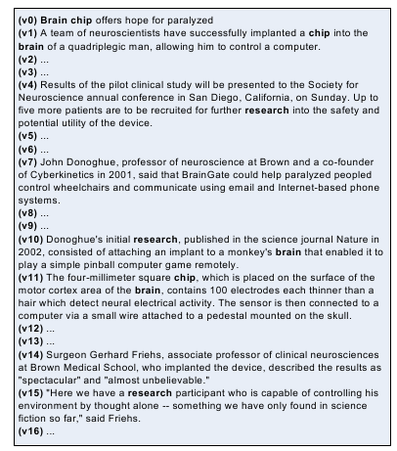
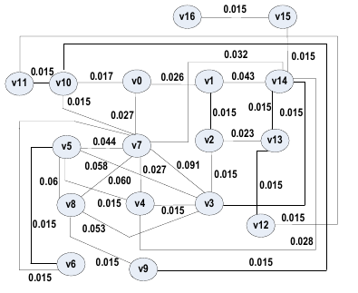
Literature Review
Notes:
Include figure from the paper

Slide 18
Literature Review
A language independent approach to multilingual text summarization by Patel, Siddiqui, and Tiwary(2007)
  described language independent extractive summarization algorithm for single document
  To determine content rich sentence they constructed
    Noun/ Proper Noun Vectors
    Document Feature Vector
    Enhanced Theme Vector
  Risk of extracting incomplete sentence tackled by Sentence Reference Index(SRI)

Slide 19
Literature Review
Terms derived from frequent sequences for extractive text summarization by Ledeneva1, Gelbukh, and Garcia-Hernandez (2008)
  Words that are part of frequent bigrams provide good description of text
  Maximal frequent sequences bear important meanings
  Algorithm adopted was
    Term Selection
    Assign weights
    Aggregate term weights to obtain sentence weight
    Select n top ranked sentences

Slide 20
Literature Review
Automatic text summarization of newswire: Lessons learned from the document understanding conference by Nenkova (2005)
  Presented analysis of variance model
  Results revealed less progress has been made on Single document summarization
  Criticized that only coverage has been used as a measure, rather than cohesion and coherence.
  User focused summaries in answer to a query is more challenging
  Stressed on parameters to characterize text to summarize (easy or hard) to develop more specialized summarizers

Slide 21
Methodology
Determine Important sentences
Position Hypothesis or Heuristics
Weight and highlight
important phrases in sentences
using n-grams
Parse Sentence(s) using POS
Tagger to identify Subject,
Object & Verb

Slide 22
Methodology
Determine Important Sentences
  Generate a pattern of sentence ordinal position using test data(news articles and extracts)
  Use this pattern to extract sentences
  Heuristics
  Use first sentence of first paragraph
  Use first and last sentence of each paragraph

Slide 23
Methodology
N-Gram to weight and highlight important phrases in sentences

Slide 24
Methodology
POS Tagger to parse sentences and identify subject, verb and object

Slide 25
Thank you

